Slide 1
Expenses

Slide 2
TRAVEL / REIMBURSEMENTS
TRAVEL for PERSONAL REIMBURSEMENTS
Oracle VS
Colleague
EMPLOYEES ARE NOT VENDORS
REQUEST FUNDS
TERM: AUTHORIZATION
GOES THRU APPROVALS
BECOMES AN EXPENSE
CREATE AN EXPENSE REPORT
GOES THRU APPROVALS
AUTOMATICALLY GOES TO AP
EMPLOYEES ARE VENDORS
REQUEST FUNDS
TERM: REQUISITION
GOES THRU APPROVALS
BECOMES A PURCHASE ORDER
CREATE DYNAMIC or TRAVEL FORM
GOES THRU APPROVALS
SEND TO AP
TA000033112664
PO 214685

Slide 3
Things to Note
Travel Reimbursed to Associate / Faculty
Completed in Expense Module
Associates/Faculty who travel weekly can do 1 expense report per week or month
There are NO open BPO’s for travel – each trip will require an authorization
(exception those who do weekly travel)
Reimbursements for College Classes will be done thru Expenses because Associates are NOT vendors

Slide 4
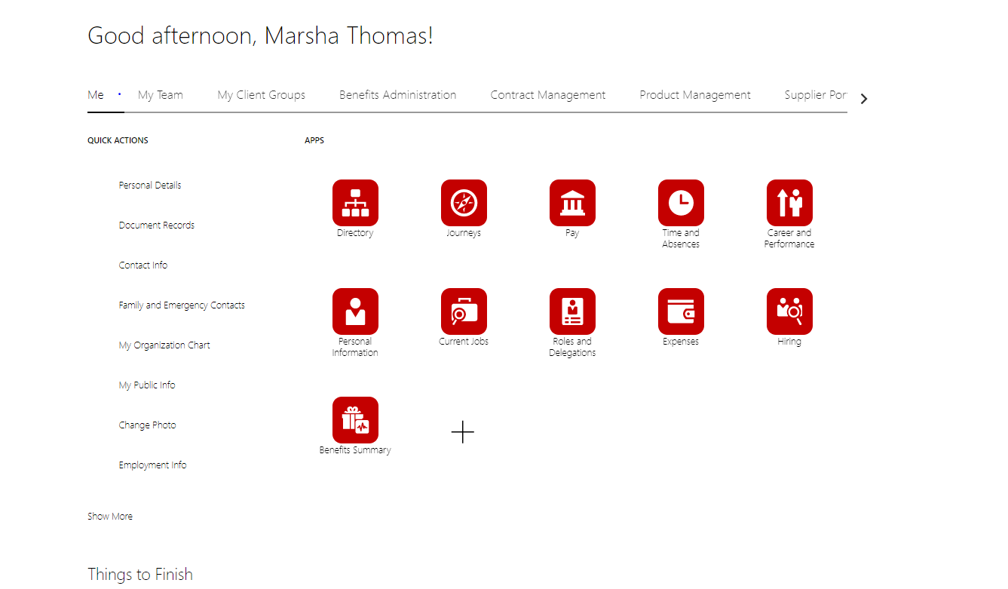

Slide 5
Authorization Request PO’s are no longer valid for Travel or Reimbursements
#2 Click Request Authorization
(you are ASKING for FUNDS for Associate or Faculty reimbursement)
#1 CLICK SNOWGLOBE ICON

Slide 6
#3 Purpose should be description w/ date
#4 Exp Location
Final destination
(auto generated as you type )
#5 Dates the expenses will occur
#6 Attachment
Itinerary, invitation, etc
#7 Click +
To itemize your expenses

Slide 7
https://gsa.gov
#8 4 Options for the Trip Expense
Staff Expense
Conference Expense
Grant Expense
Recruiting Expense
#11 Save & Create Another to add more expense lines
Save & Close to complete
#9 Type
Drop Box to drill down on the exact reason of reimbursement
#4 These boxes will change and correspond to the TYPE you choose (step2)
#5 You must change your GL account. If you are splitting a gl account to two different depts you will have to create this expense line two times and ask for the funds to go with each GL account.
#10 Amount you expect to pay out
NOTE*
If you spend more than asked for you will have to do another expense report for the difference
If you spend less than you have asked for, the remainder of the expense will need to be released by the budget manager (Teresa Sutton) to put the funds back into your budget.

Slide 8
#12 Submit to send for Approvals and goes thru funds check
Or Save and close to go back to later
Your Authorization shows as Pending Manager Approval
Note: if authorization fails funds check it will show as SAVED (you will need to do a budget transfer) & resubmit

Slide 9
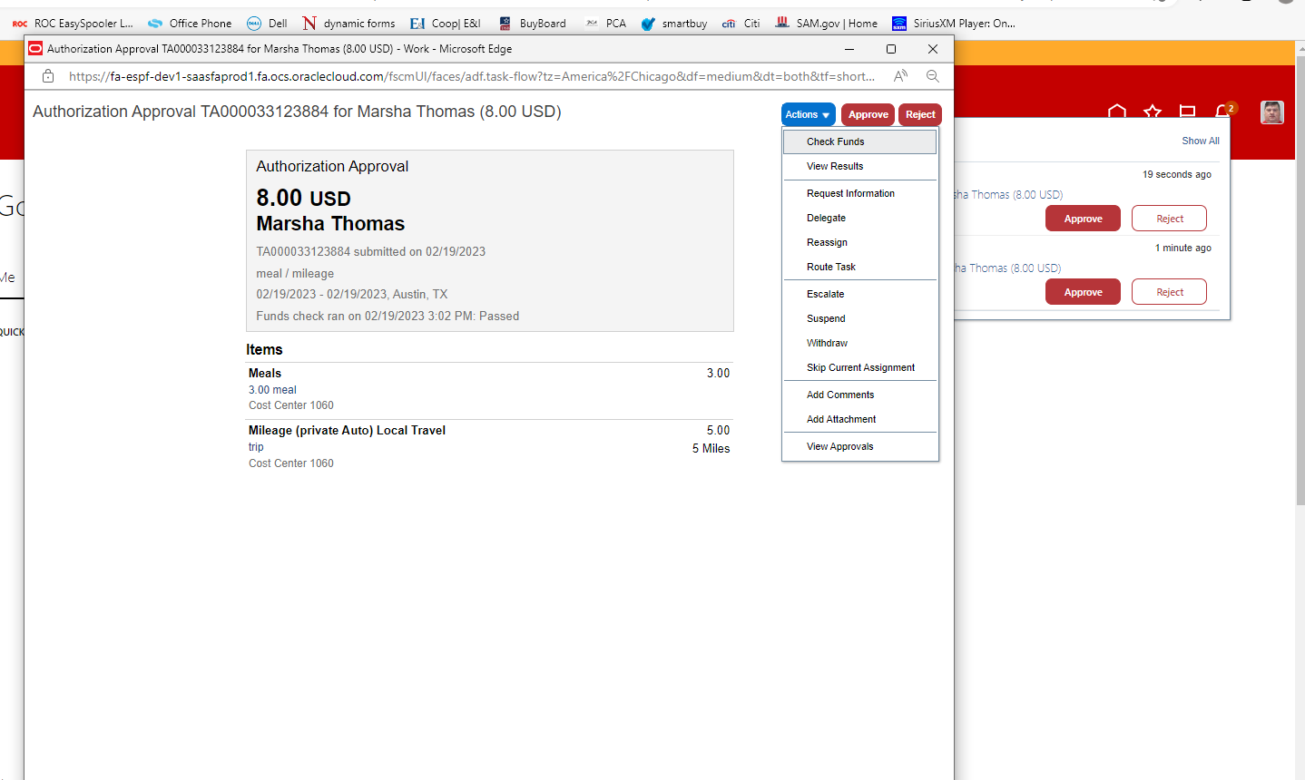
Manager Approval / A Manager can Reassign to another Approver
IF you click the blue hyperlink it opens this window to see details.

Slide 10
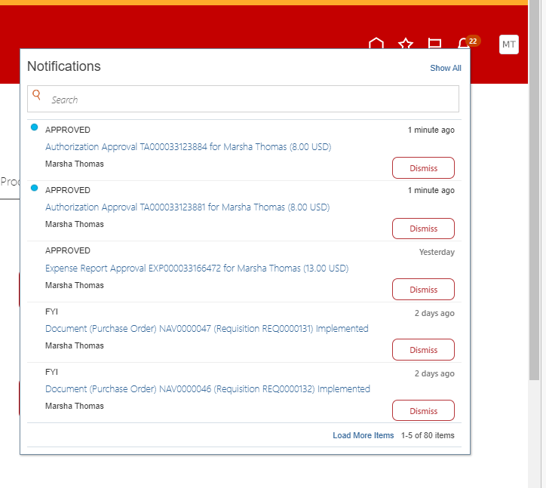
Your request to spend funds
AUTHORIZATION
is approved, you can now plan your trip.
Approved to take the trip

Slide 11
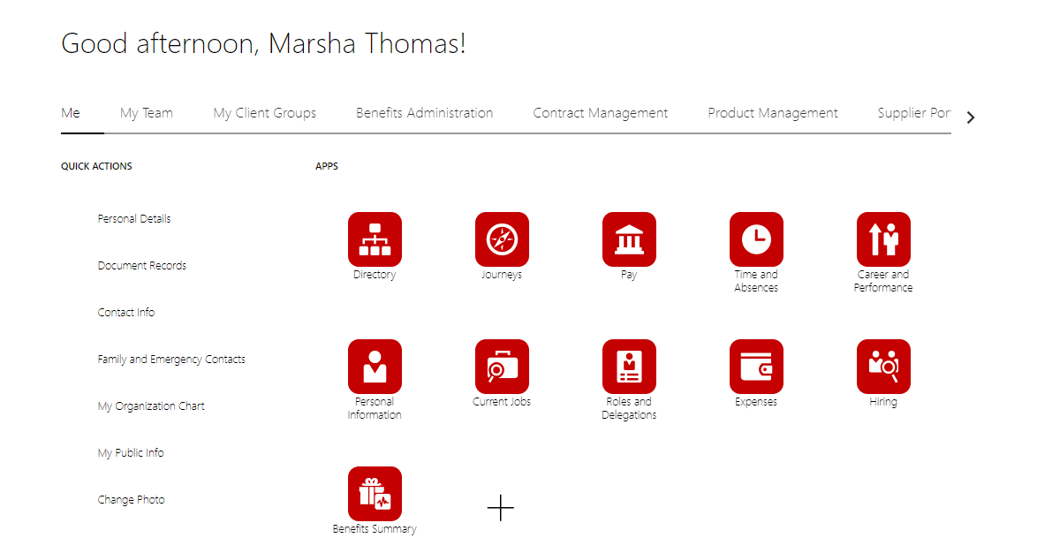
You are Back from the Trip and Need to Ask for Personal Reimbursement
Only Expense Reports
(NOT Authorizations) show on this turntable.. The more you do the more will be lined up across the page.

Slide 12
#1 Type in the same name as the request!
#2 Click to create expense lines
#4 Attach receipt(s) for this line charge
(drag and drop option)
#5 click Authorization (this is when you asked for funds) opens to a new box
#3 Page opens and changes expense lines depending on the Type you pick.
Make sure the gl account matches the account used when funds were requested before the trip

Slide 13
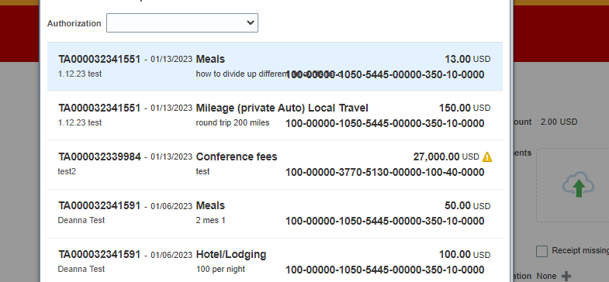
#6 Find your Original Request for this line item – click (turns blue) go to bottom of page and click ok
You need to know your TA# (Authorization #) to find the correct line / trip/ expense
Note: each line item shows here separately w/ the original Travel Authorization Number - TA000000000

Slide 14
The Authorization you selected from previous screen
Receipt(s) you attached earlier
#7 If you have more expense lines create another
or save & close

Slide 15
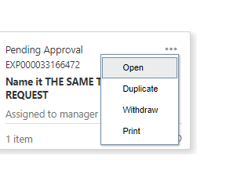
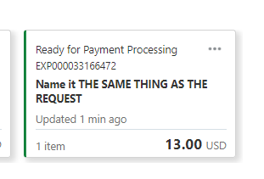
It has now changed to an EXPENSE
This is the Expense NUMBER
#8 Submit
Or save for later
If you receive an error, see next slide
This is why you name the Authorization and the Expense the same..
Also see next slide

Slide 16
If you forget to change the gl (fund) account when you created the Expense. You will receive an error. This must be fixed because the funds have been dedicated to this transaction

Slide 17
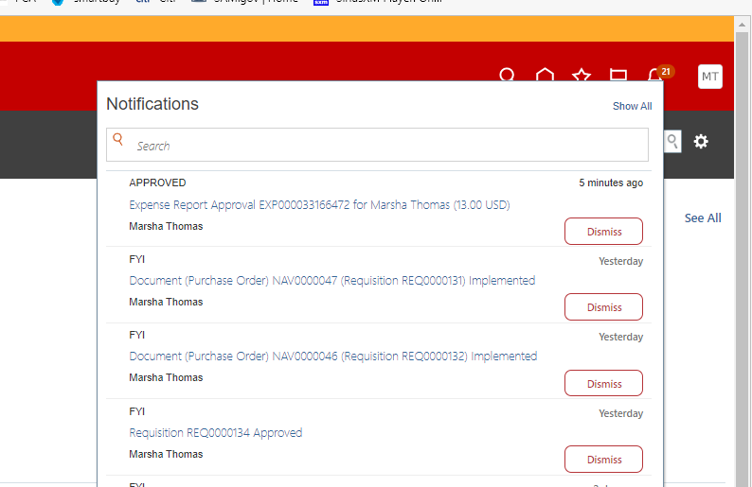
The person asking for the reimbursement will receive a message in the Bell Notification
Does not go back thru approval process since it was approved at Authorization level

Slide 18
How To Tips for Travel Expenses
Meals
Authorization (asking for funds) Include total amount of funds of all meals on one line expense
In the description break down the meals by day / bk, lunch, dinner / amount
Ex. 1/1/23 – bk @ 7$ Dinner @ $18 (gsa.gov) for allowable amount
During the Expense Report (asking of reimbursement) you will upload all receipts for the expenses
Mileage
During the Expense Report (asking of reimbursement) you will need Mapquet (or other maps) to upload
Your ending location is the destination town
During Expense Report - Make sure you click calculate at the top of the page
Missing Receipts
If a receipt is not attached your Expense will automatically go to Audit. We will look at your Expense and gather more information before approving expense
Auditing Expenses
Expenses are automictically pulled for various reasons to be Audited
Random audits are pulled by the system for us to Audit

Slide 19
Expense not on Original Authorization or Expenses over Authorized amount
You will receive an error if the expense is over authorized amount
You will have to create a new Authorization for the
missed Expense or Overage
You will need to input “Overage” in the Purpose line and add information in the description

Slide 20
Citi Card Questions
The Associate responsible for the card reconciliation HAS to do the Authorization (request of funds)
Because all charges are attached to this person.. You will change the gl account to match the person needing the funds.
All charges are attached to the Associate number on the Citicard file (maintained by Procurement Officer)
I have placed the current Associate number on all Citicards that are currently sending me the reconciliation
Generic Dept Cards will be maintained by one person – all charges from that card will show on that Associates Expense page
Campus cards – Corsicana (10) Waxhachie (4) Midlothian (3) Mexia (3) Maintenance (10) will be maintained by one person on each campus and all charges will show on that persons Expense page.
ONLY THE PERSON RESPONSIBLE FOR THE PCARD RECONCILATION
CAN DO THE REQUEST FOR FUNDS
TO USE THE CITTICARD
(Citicard is NOT a Vendor )

Slide 21
Citicard Questionnaire
A Citicard request questionnaire will be available soon on MYNC – Staff Forms
This questionnaire will be attached to the Authorization by the Pcard Responsible Associate
The Pcard Responsible Associate can have these questionnaires on hand / uploaded
When its time to reconcile in March - we will do one on one training because
ALL FEBRUARY CHARGES WILL HAVE TO HAVE A NEW AUTHORIZATION
AND EXPENSED IN ORACLE before we can reconcile.
Please look for all your PO’s for February charges .. It will help if you have them

